Slide 1
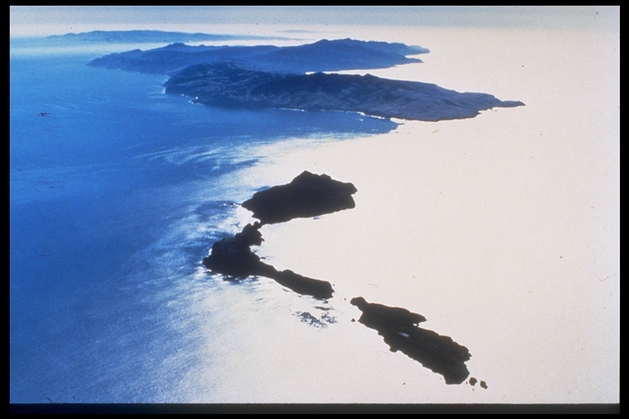
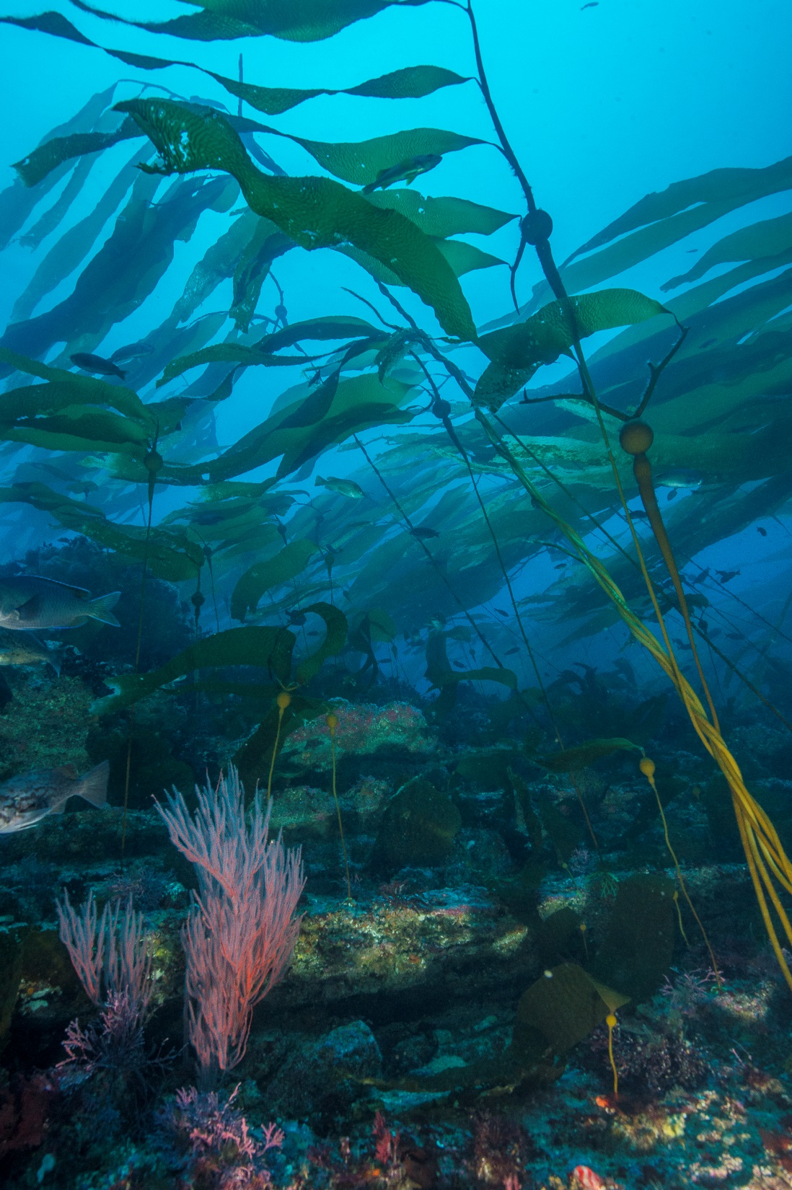
Kelp Forest Monitoring Program Update
Joshua Sprague and David Kushner

Slide 2
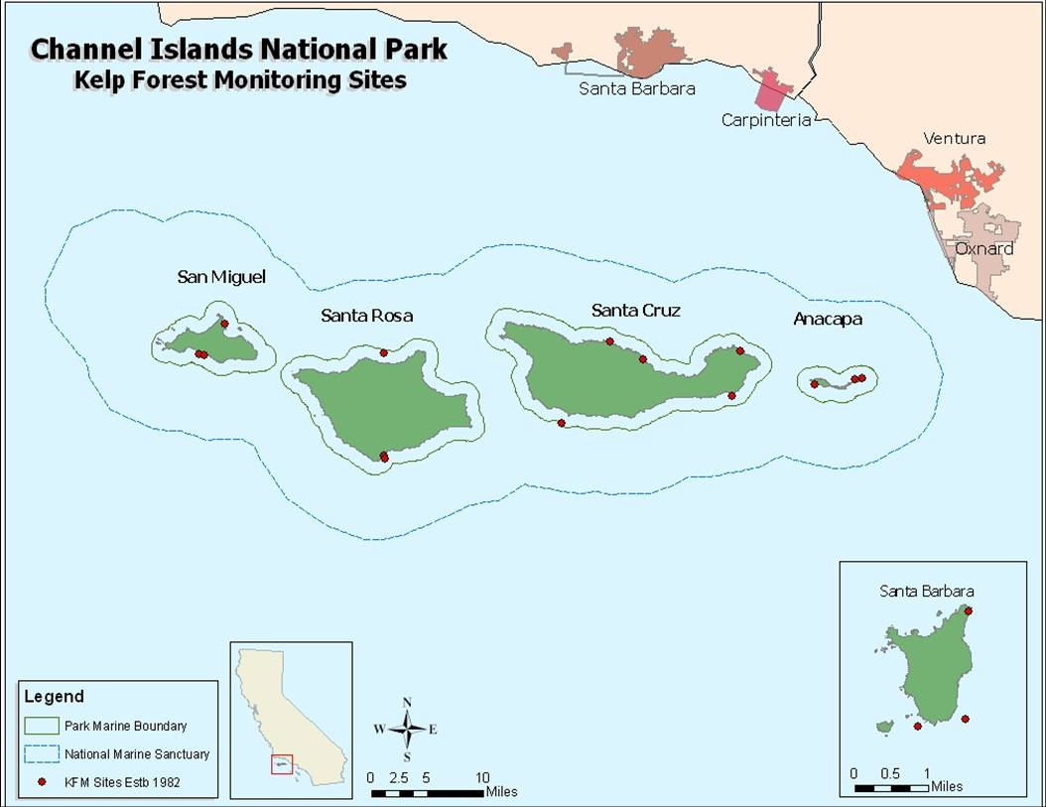
1982-2004
Old Anacapa reserve (e. 1978)
Notes:
Original sites funded by I and M program. However, program deficient and needed a growing and considerable influx of soft money to continue
Old Anacapa Reserve is 37 acres

Slide 3
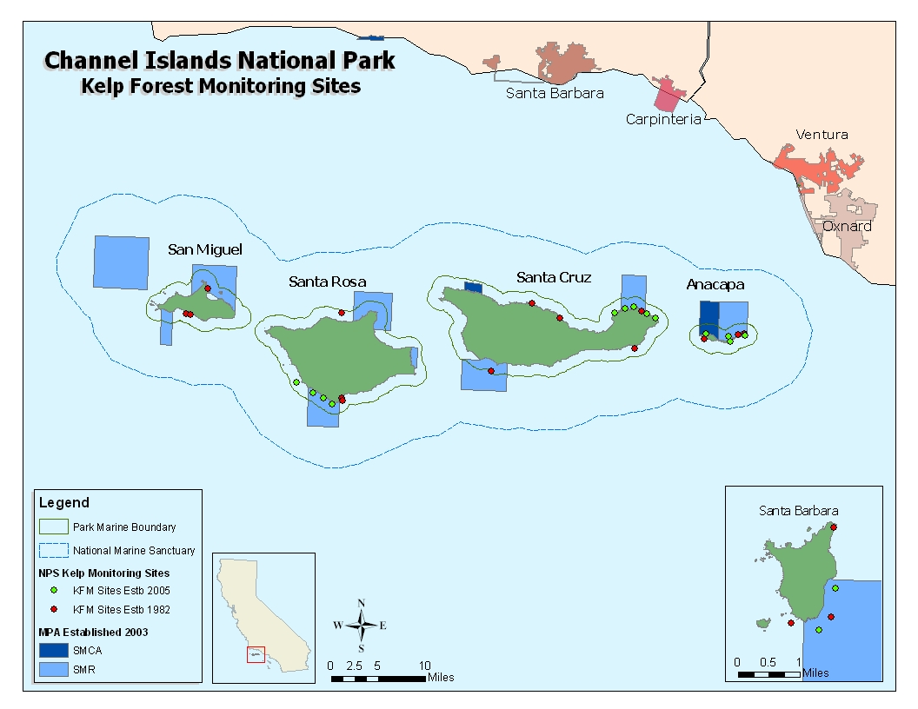
2005 – present
New Anacapa reserve (e. 2003)
Old Anacapa reserve (e. 1978)
Notes:
Initially funded by NRPP as a fine scale study to collect baseline information. CESU agreement with PISCO/UCSB for fish monitoring… Initiated their interest.

Slide 4
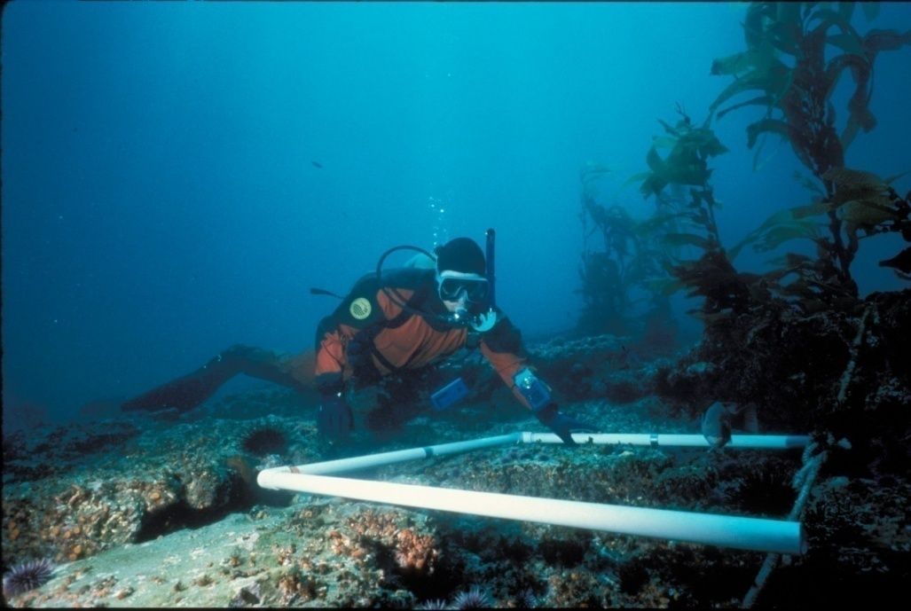
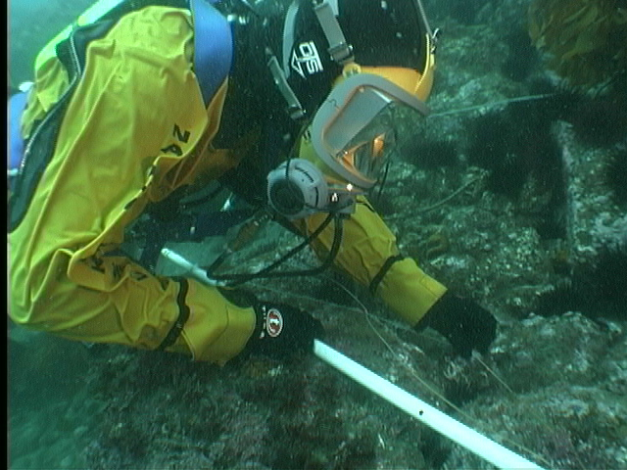
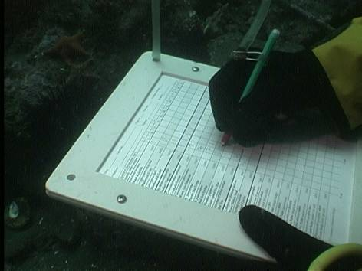
KFM Protocols:
Quadrats
5-m Quadrats
Band Transects
Random Point Contacts
Size Frequencies
Fish Transects
Roving Diver Fish Counts
Fish Size Frequencies
Artificial Recruitment Modules
Video Transects
Water Temperature
Species List

Slide 5

Alien Species Update

Slide 6
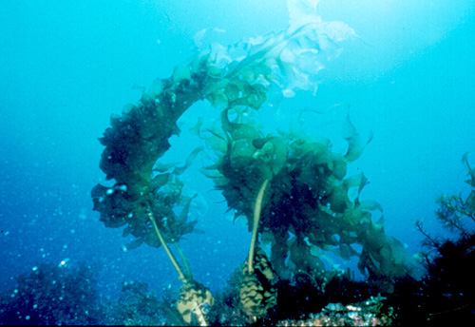


Alien Species
Undaria pinnatifida
“Wakame”
CSIRO Marine Research

Slide 7
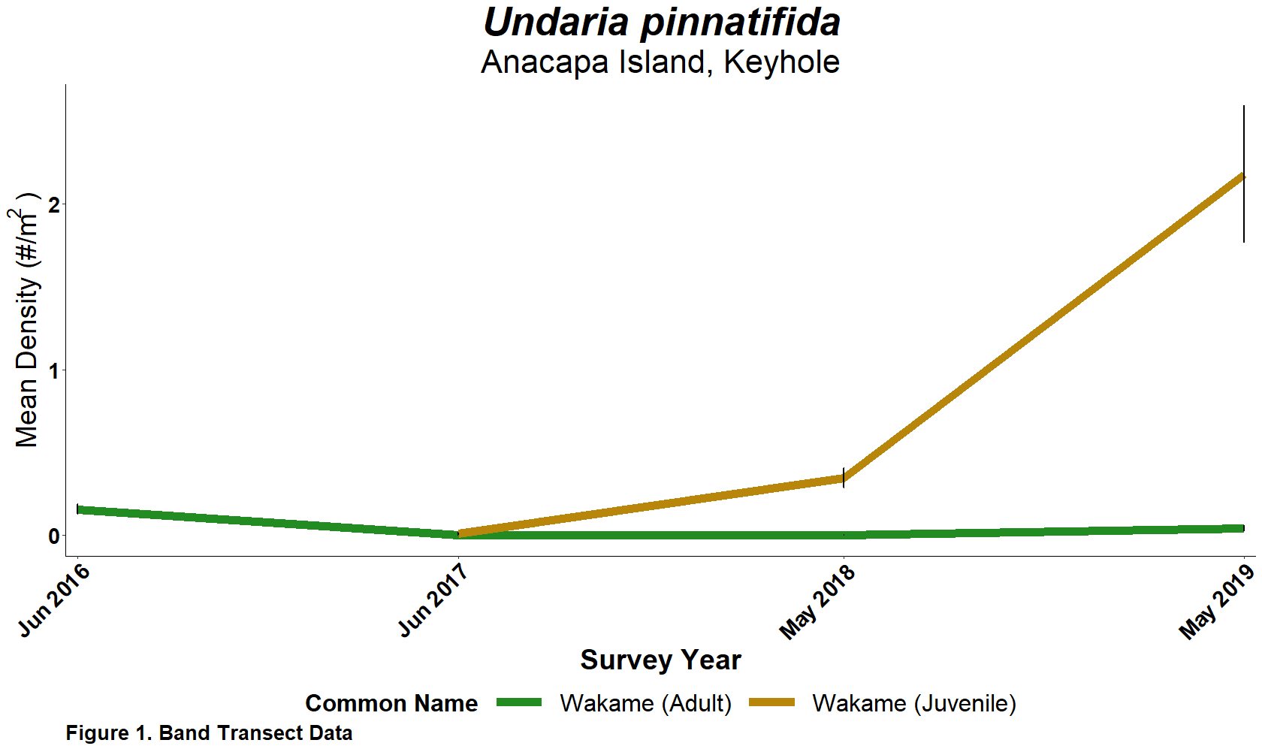


Slide 8
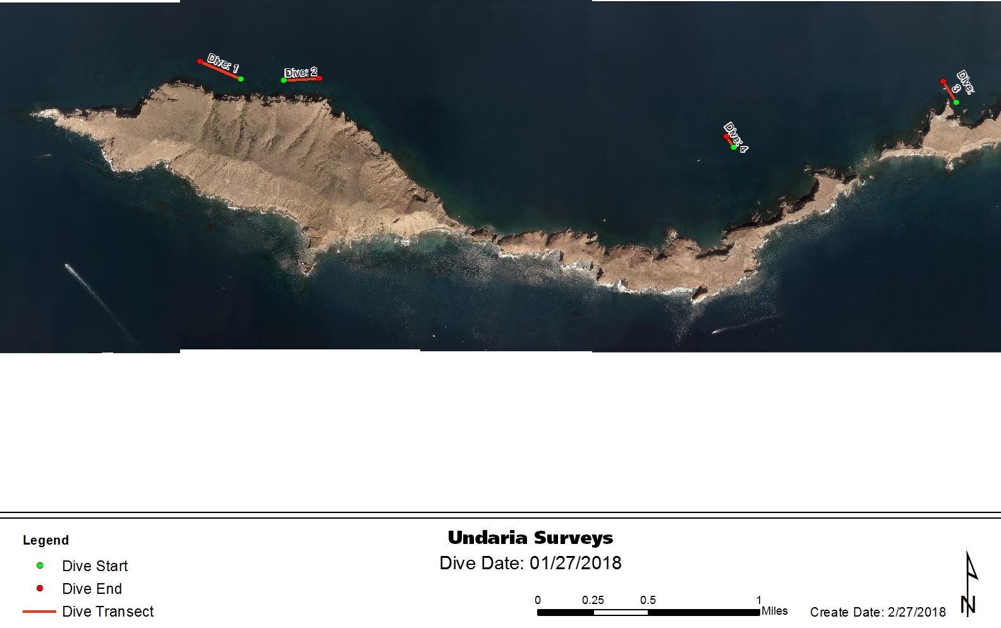

Slide 9
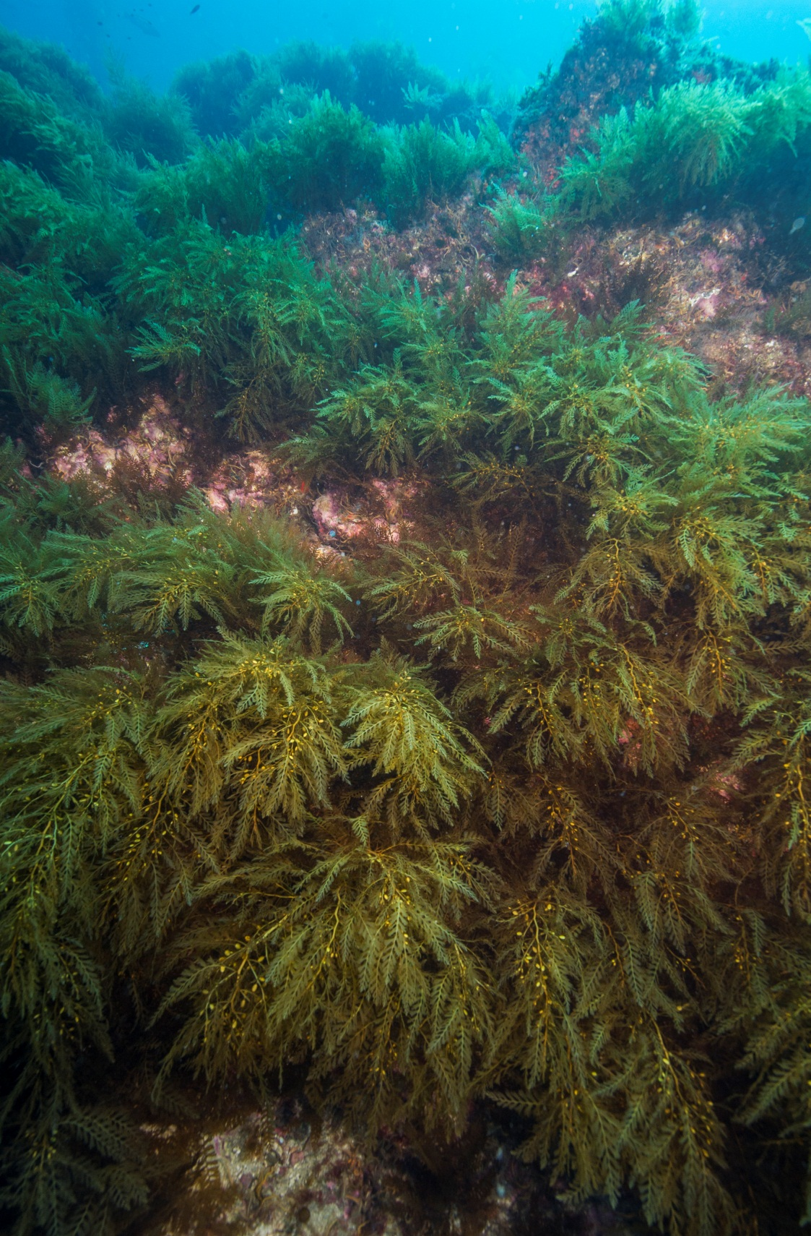
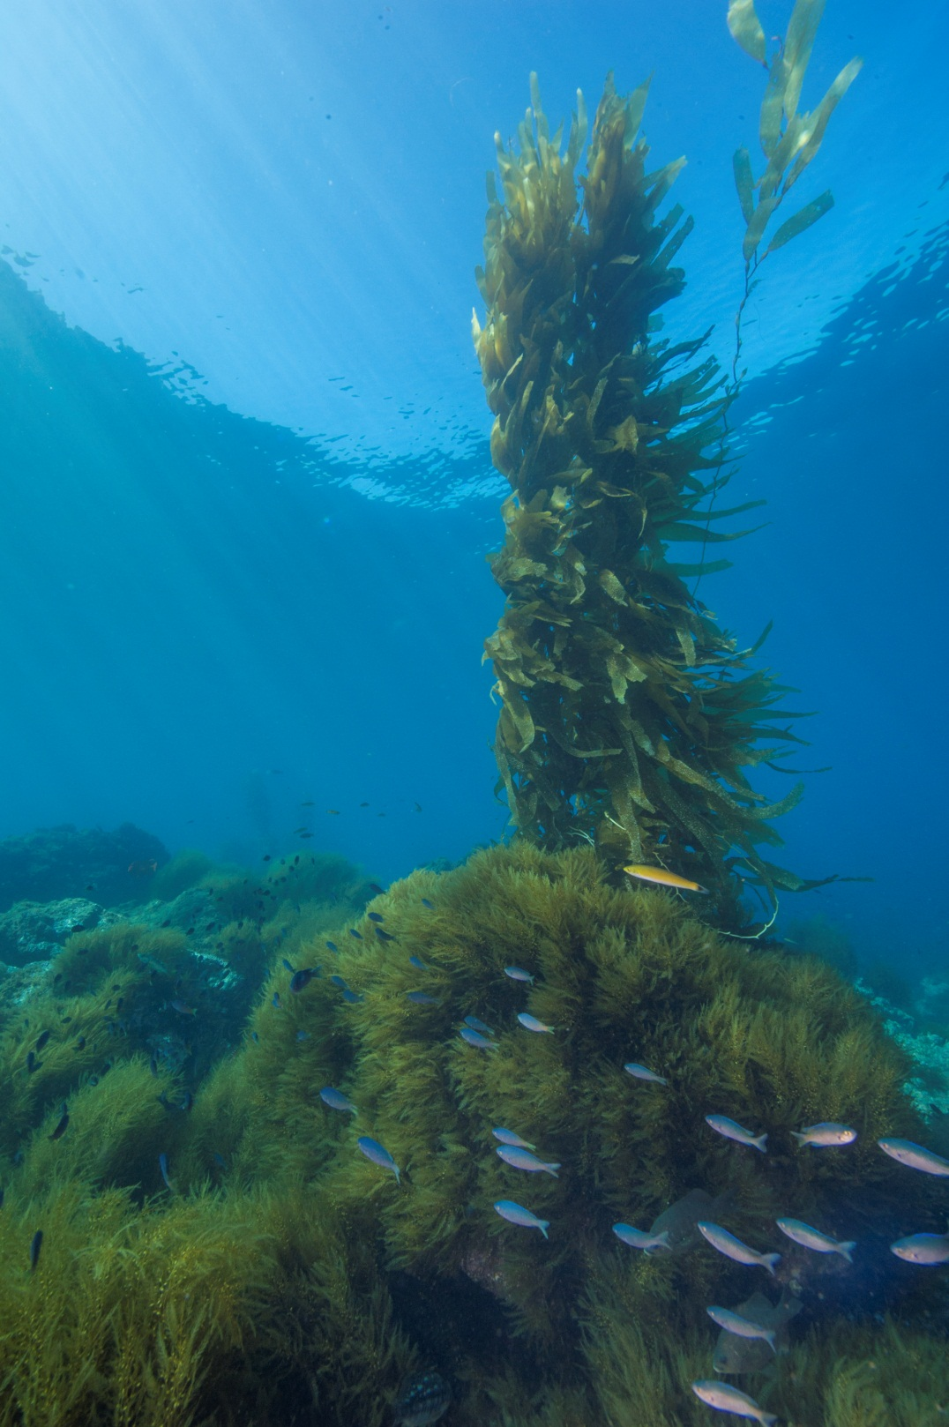
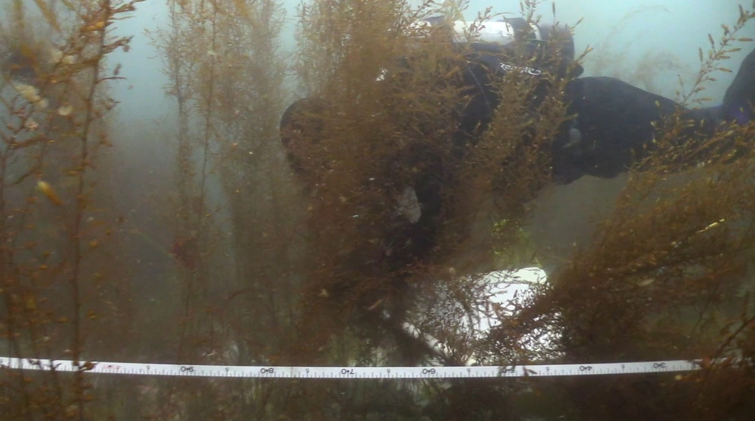
Sargassum horneri dominating kelp forest habitat at the Channel Islands.

Slide 10
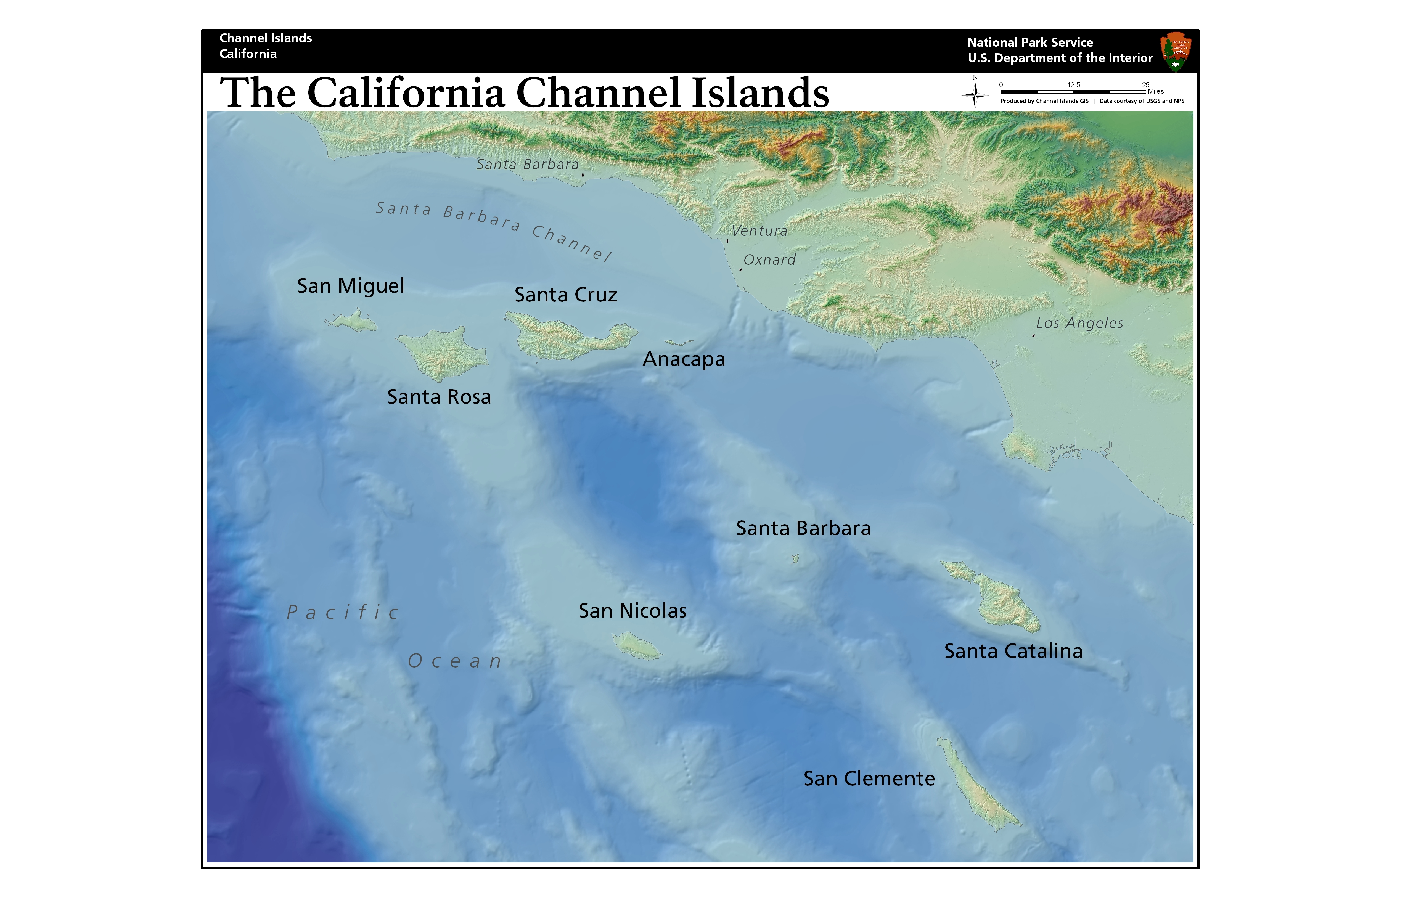
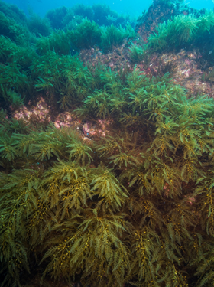
Sargassum horneri distribution (Aug 2019)
2010
2009
2015
2013
2003
2006
2010
2007
Kelp Forest Monitoring Site Locations
Locations of Sargassum horneri
2012

Slide 11
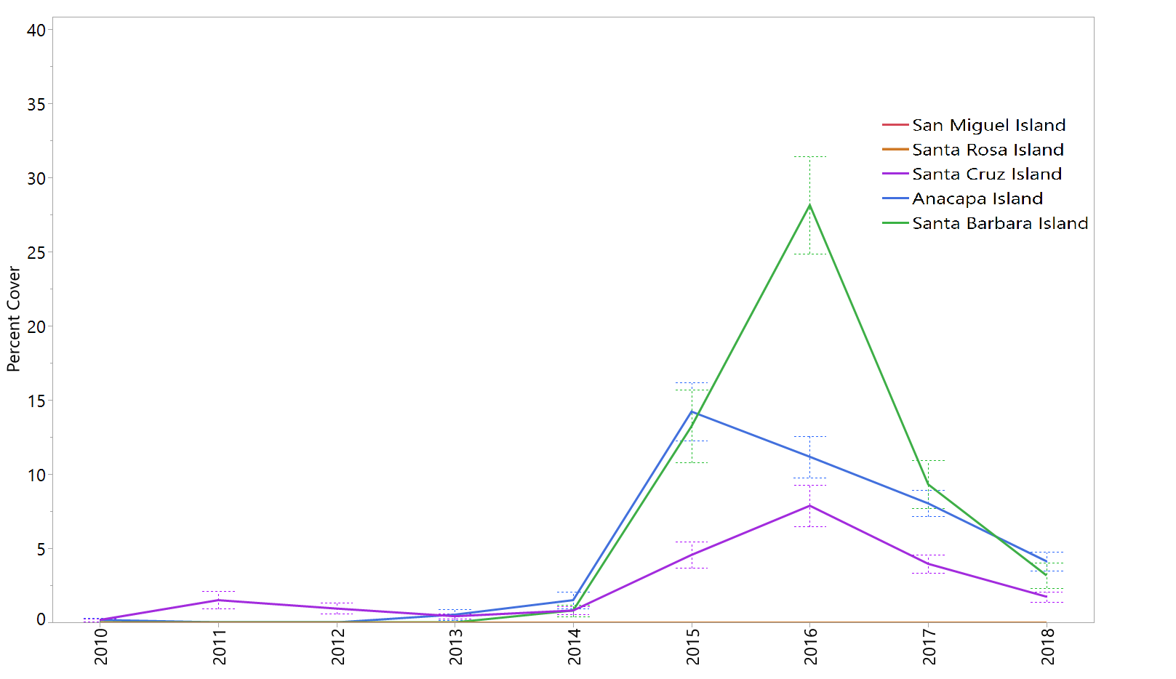
Sargassum horneri

Slide 12
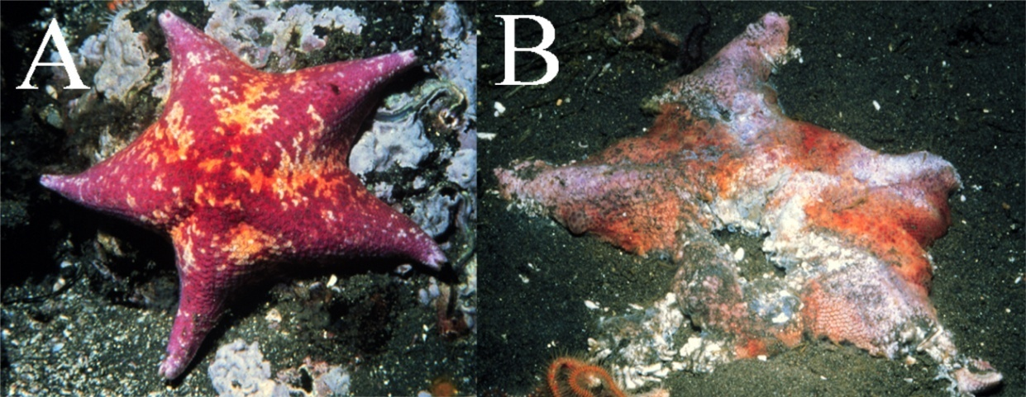
Sea star disease and population declines at CHIS
El Niño
Notes:
Warm water events, El Niño's increase prevalence of wasting disease. Hence, warm water creates population decreases for bat stars.

Slide 13
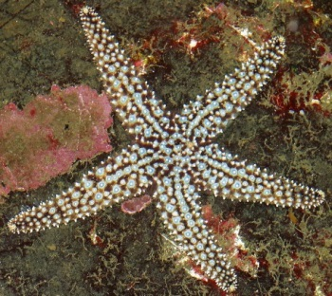

Slide 14
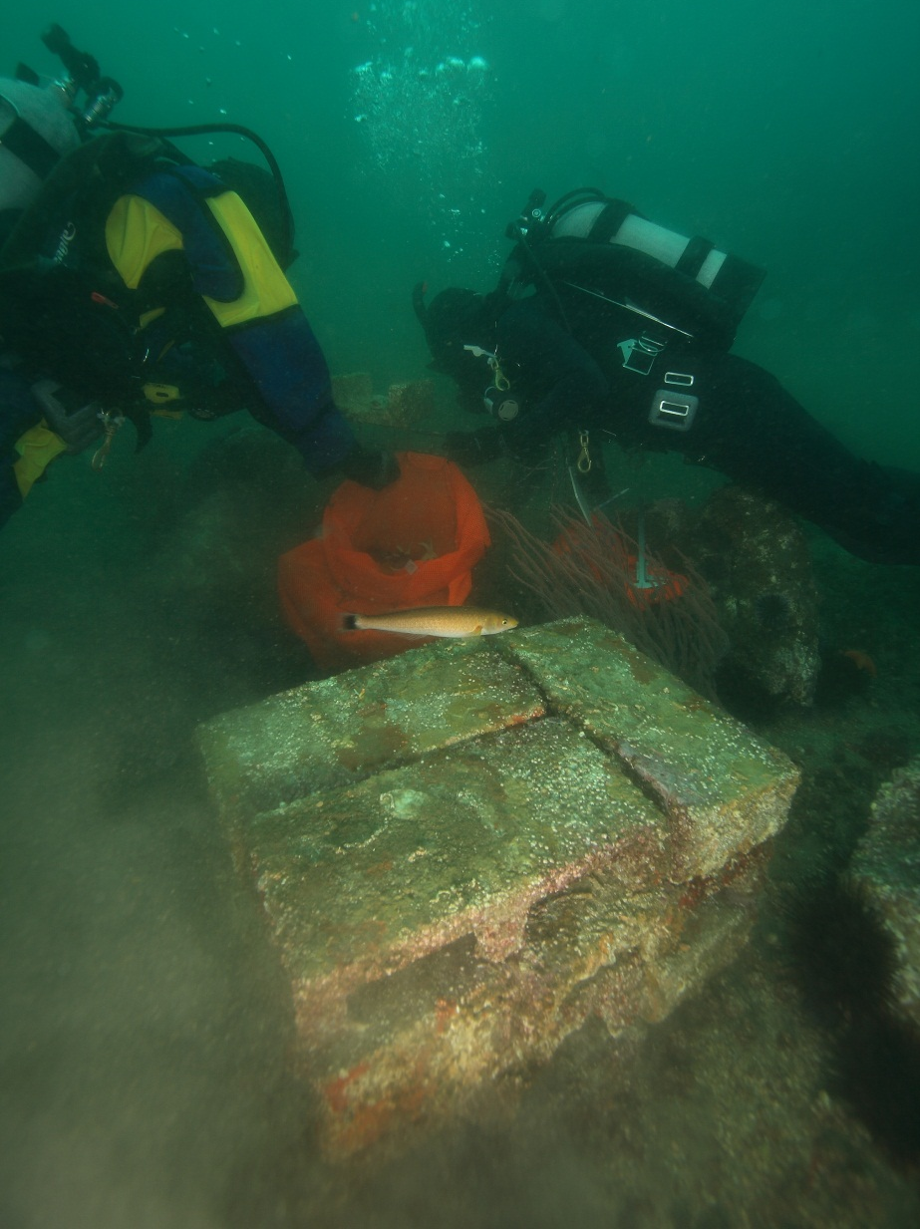
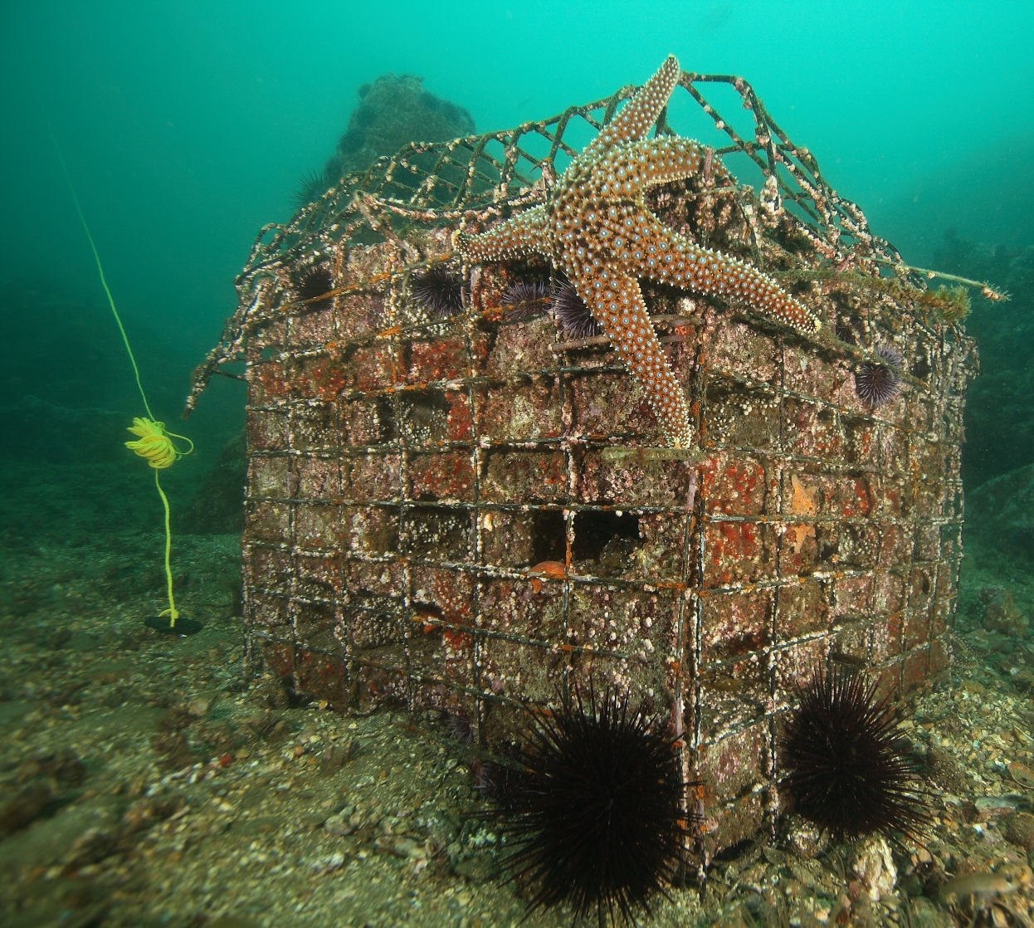
Artificial Recruitment Modules

Slide 15
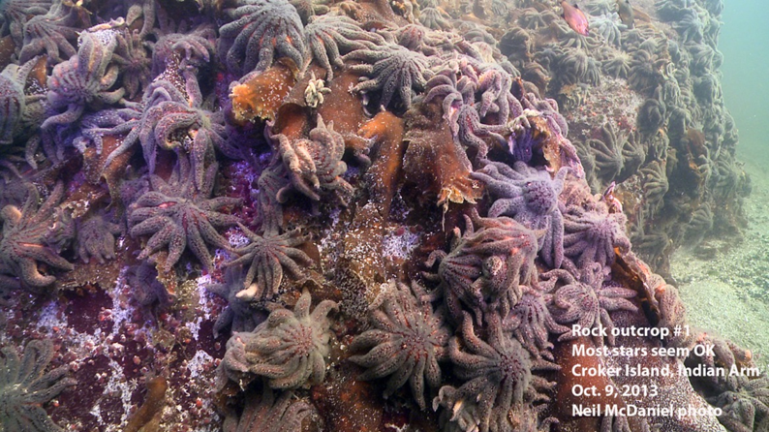
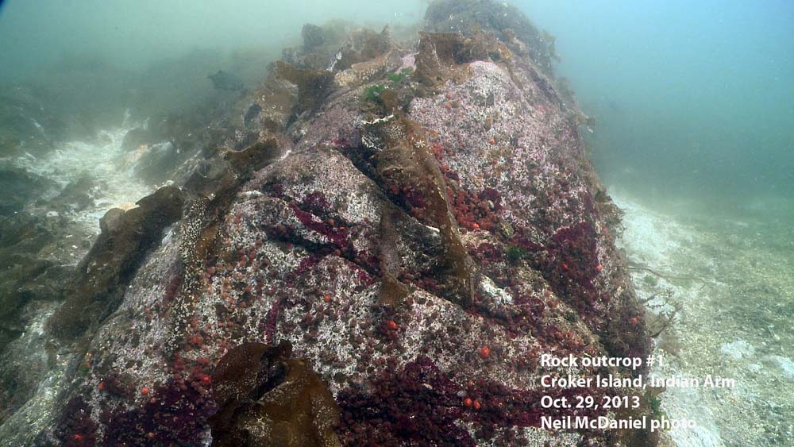
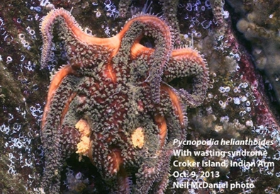

Slide 16
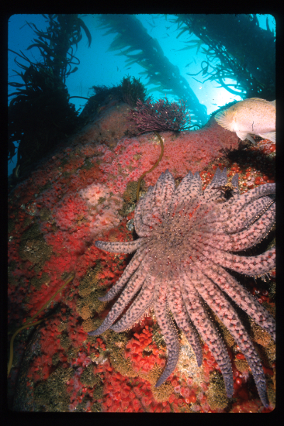
Notes:
Population seem to increase post cold water events such as La Ninas

Slide 17




Slide 18
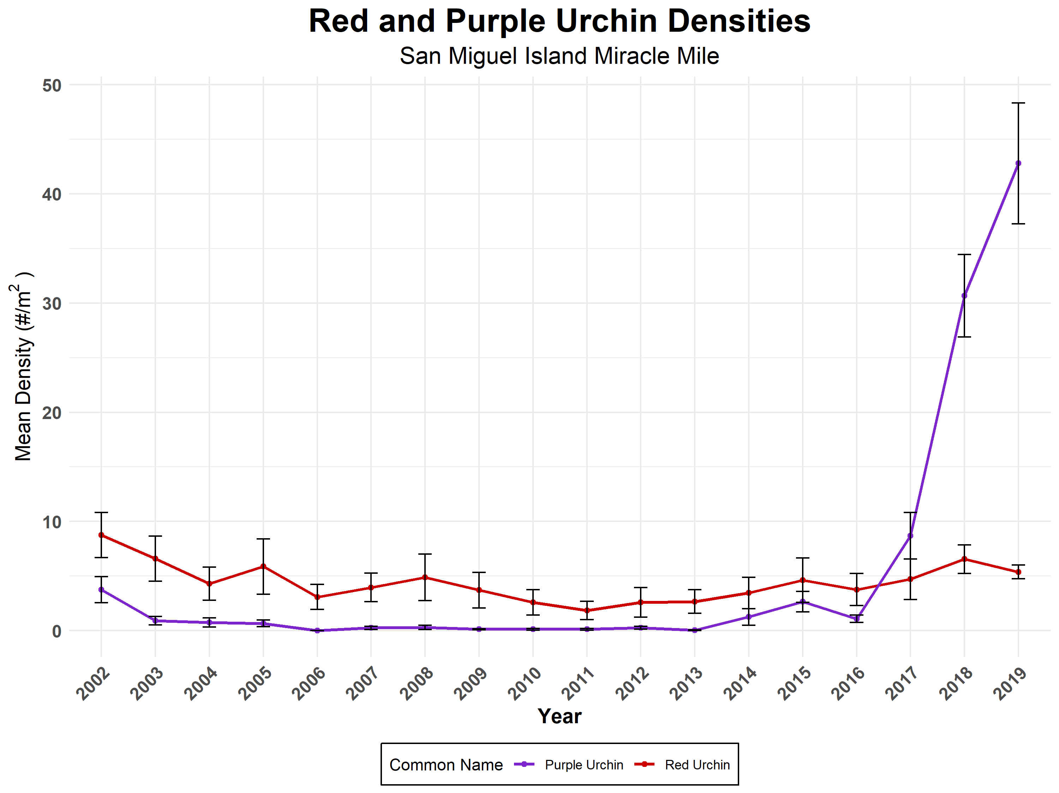
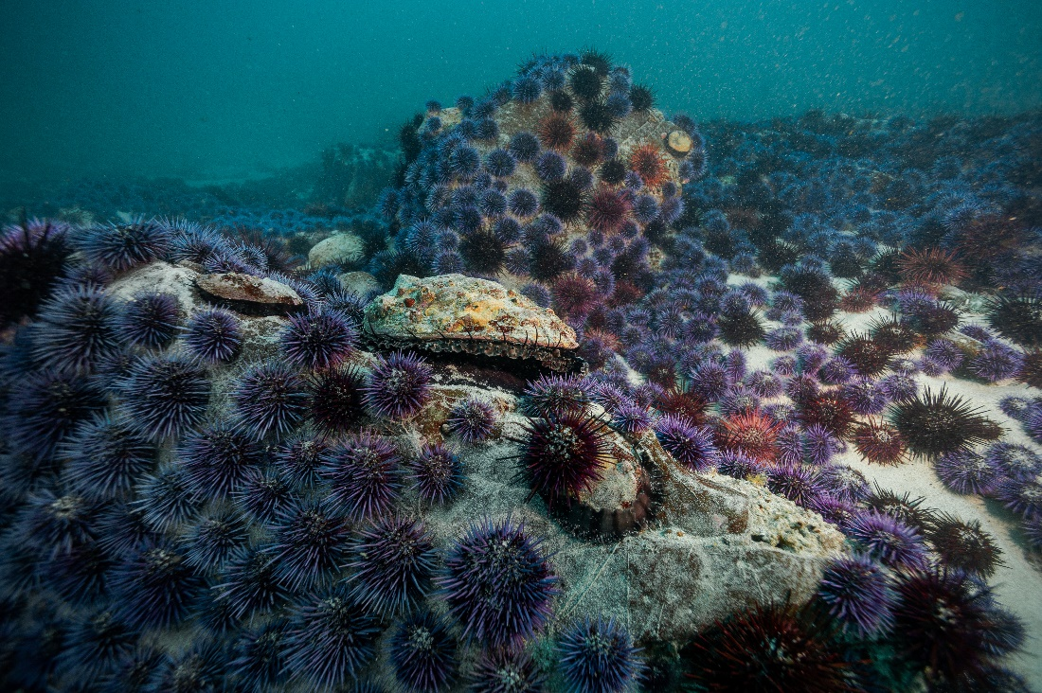

Slide 19
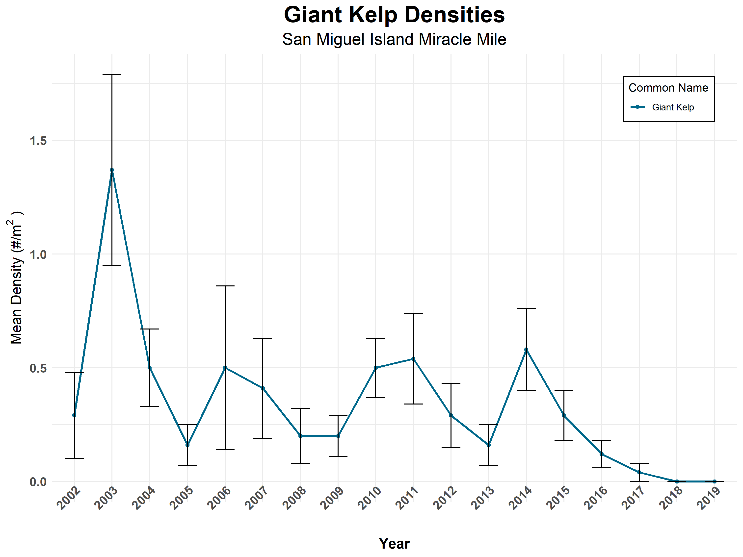
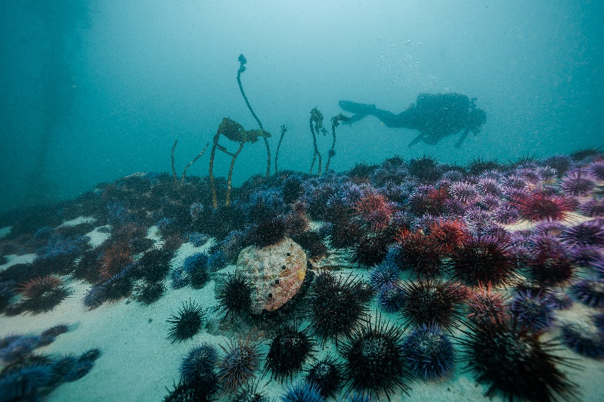

Slide 20
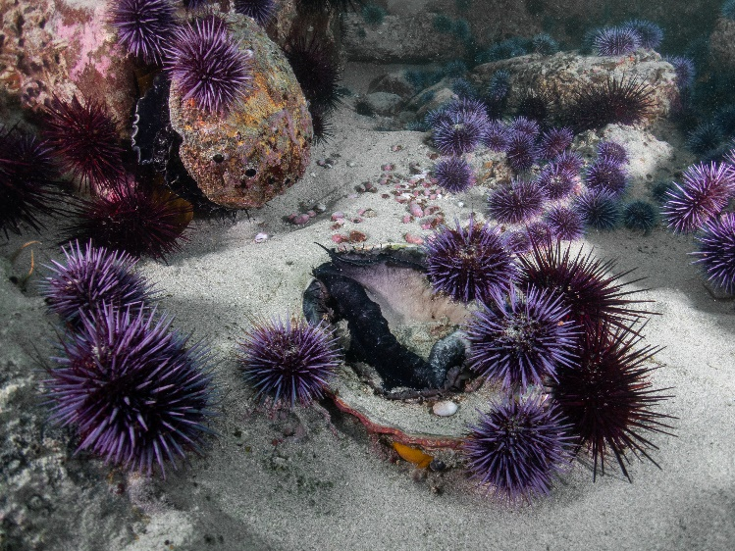
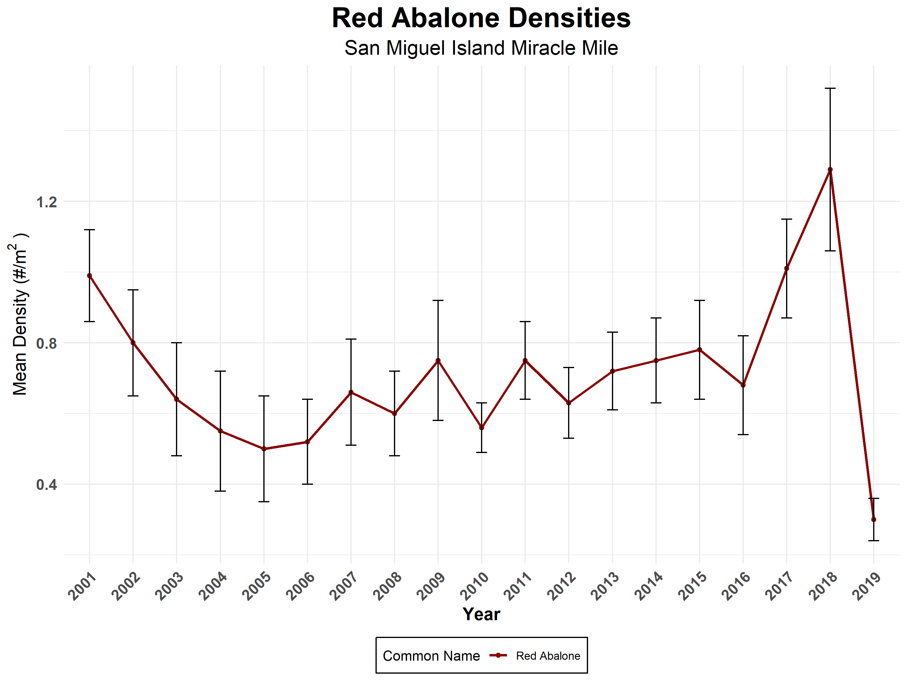

Slide 21
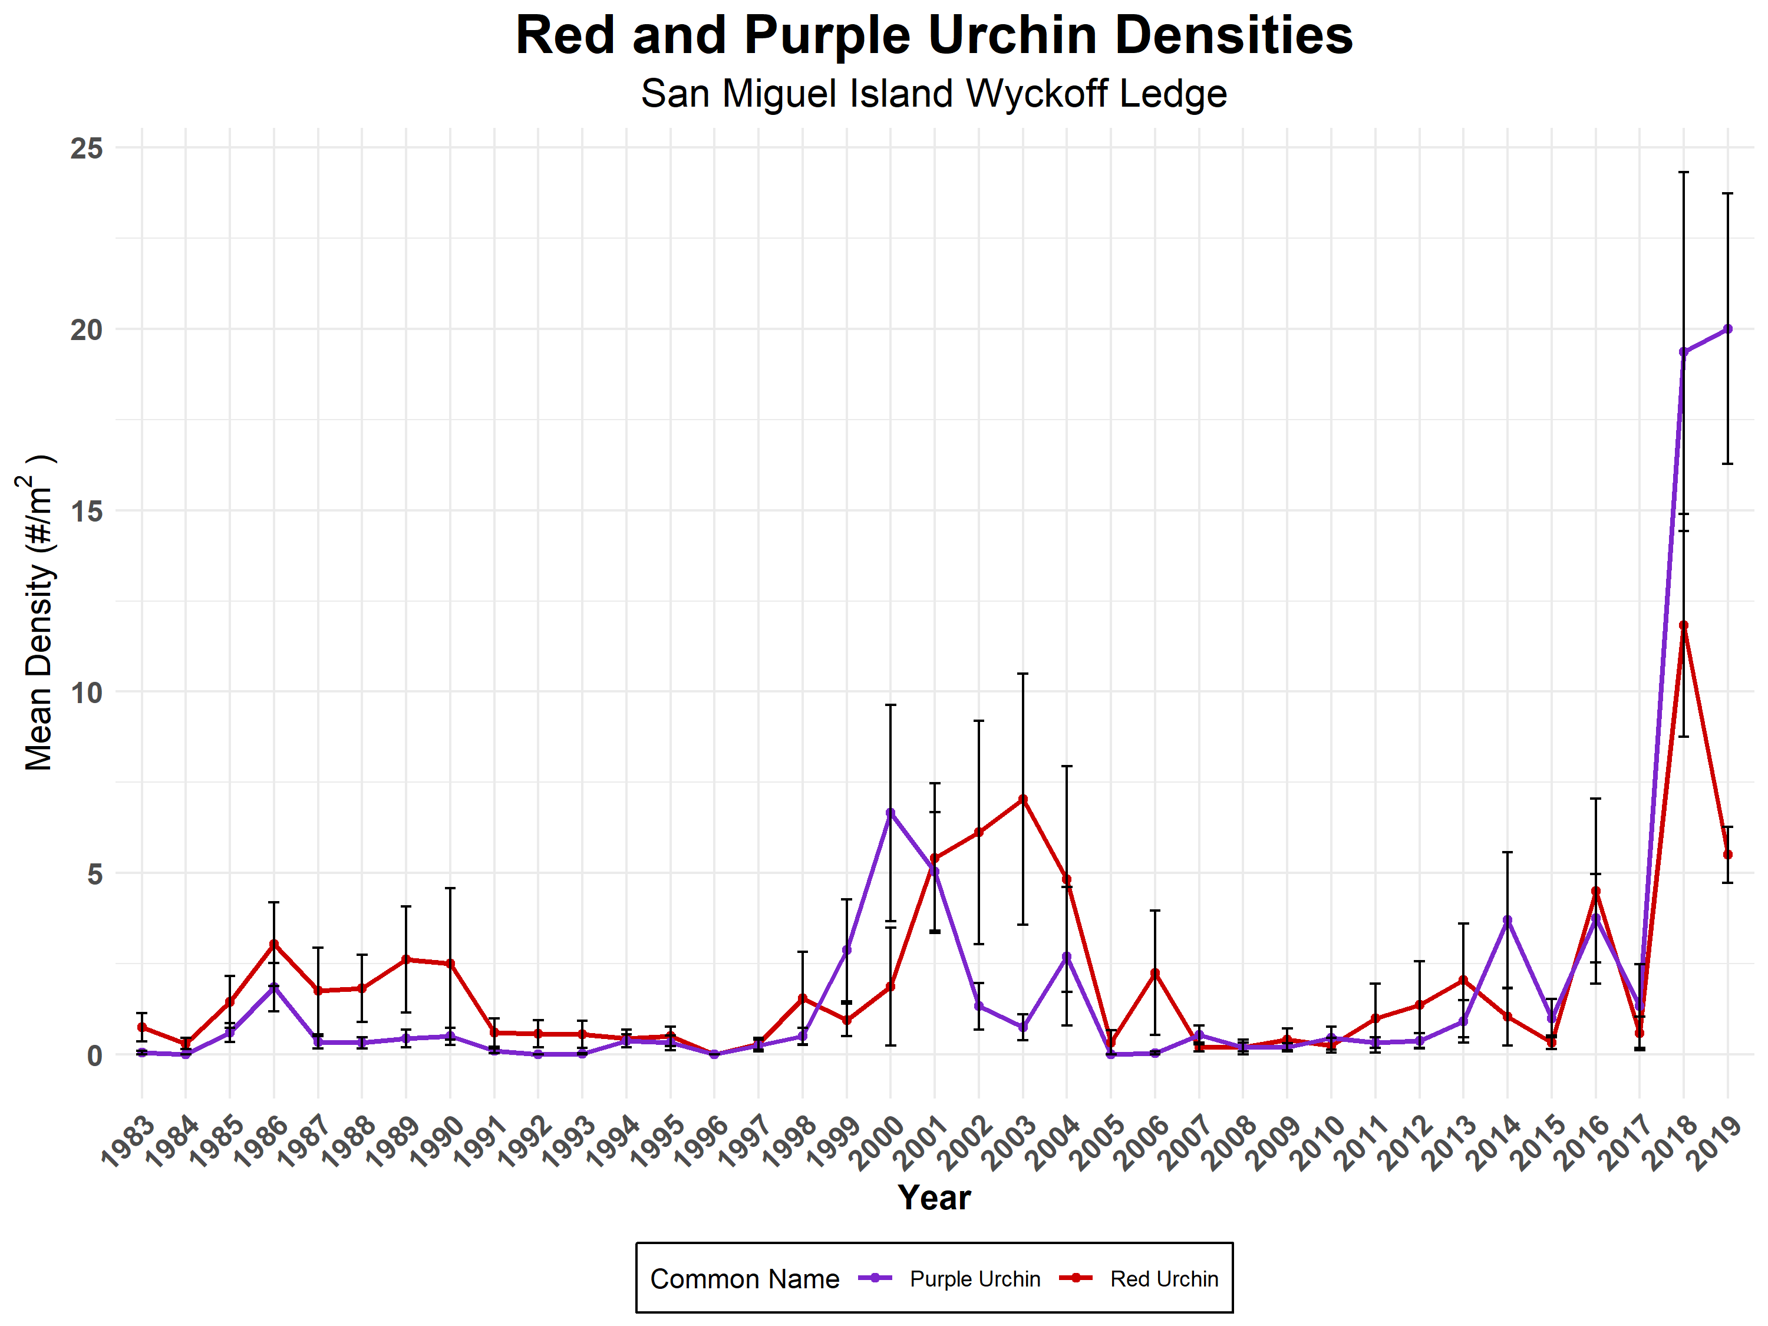

Slide 22
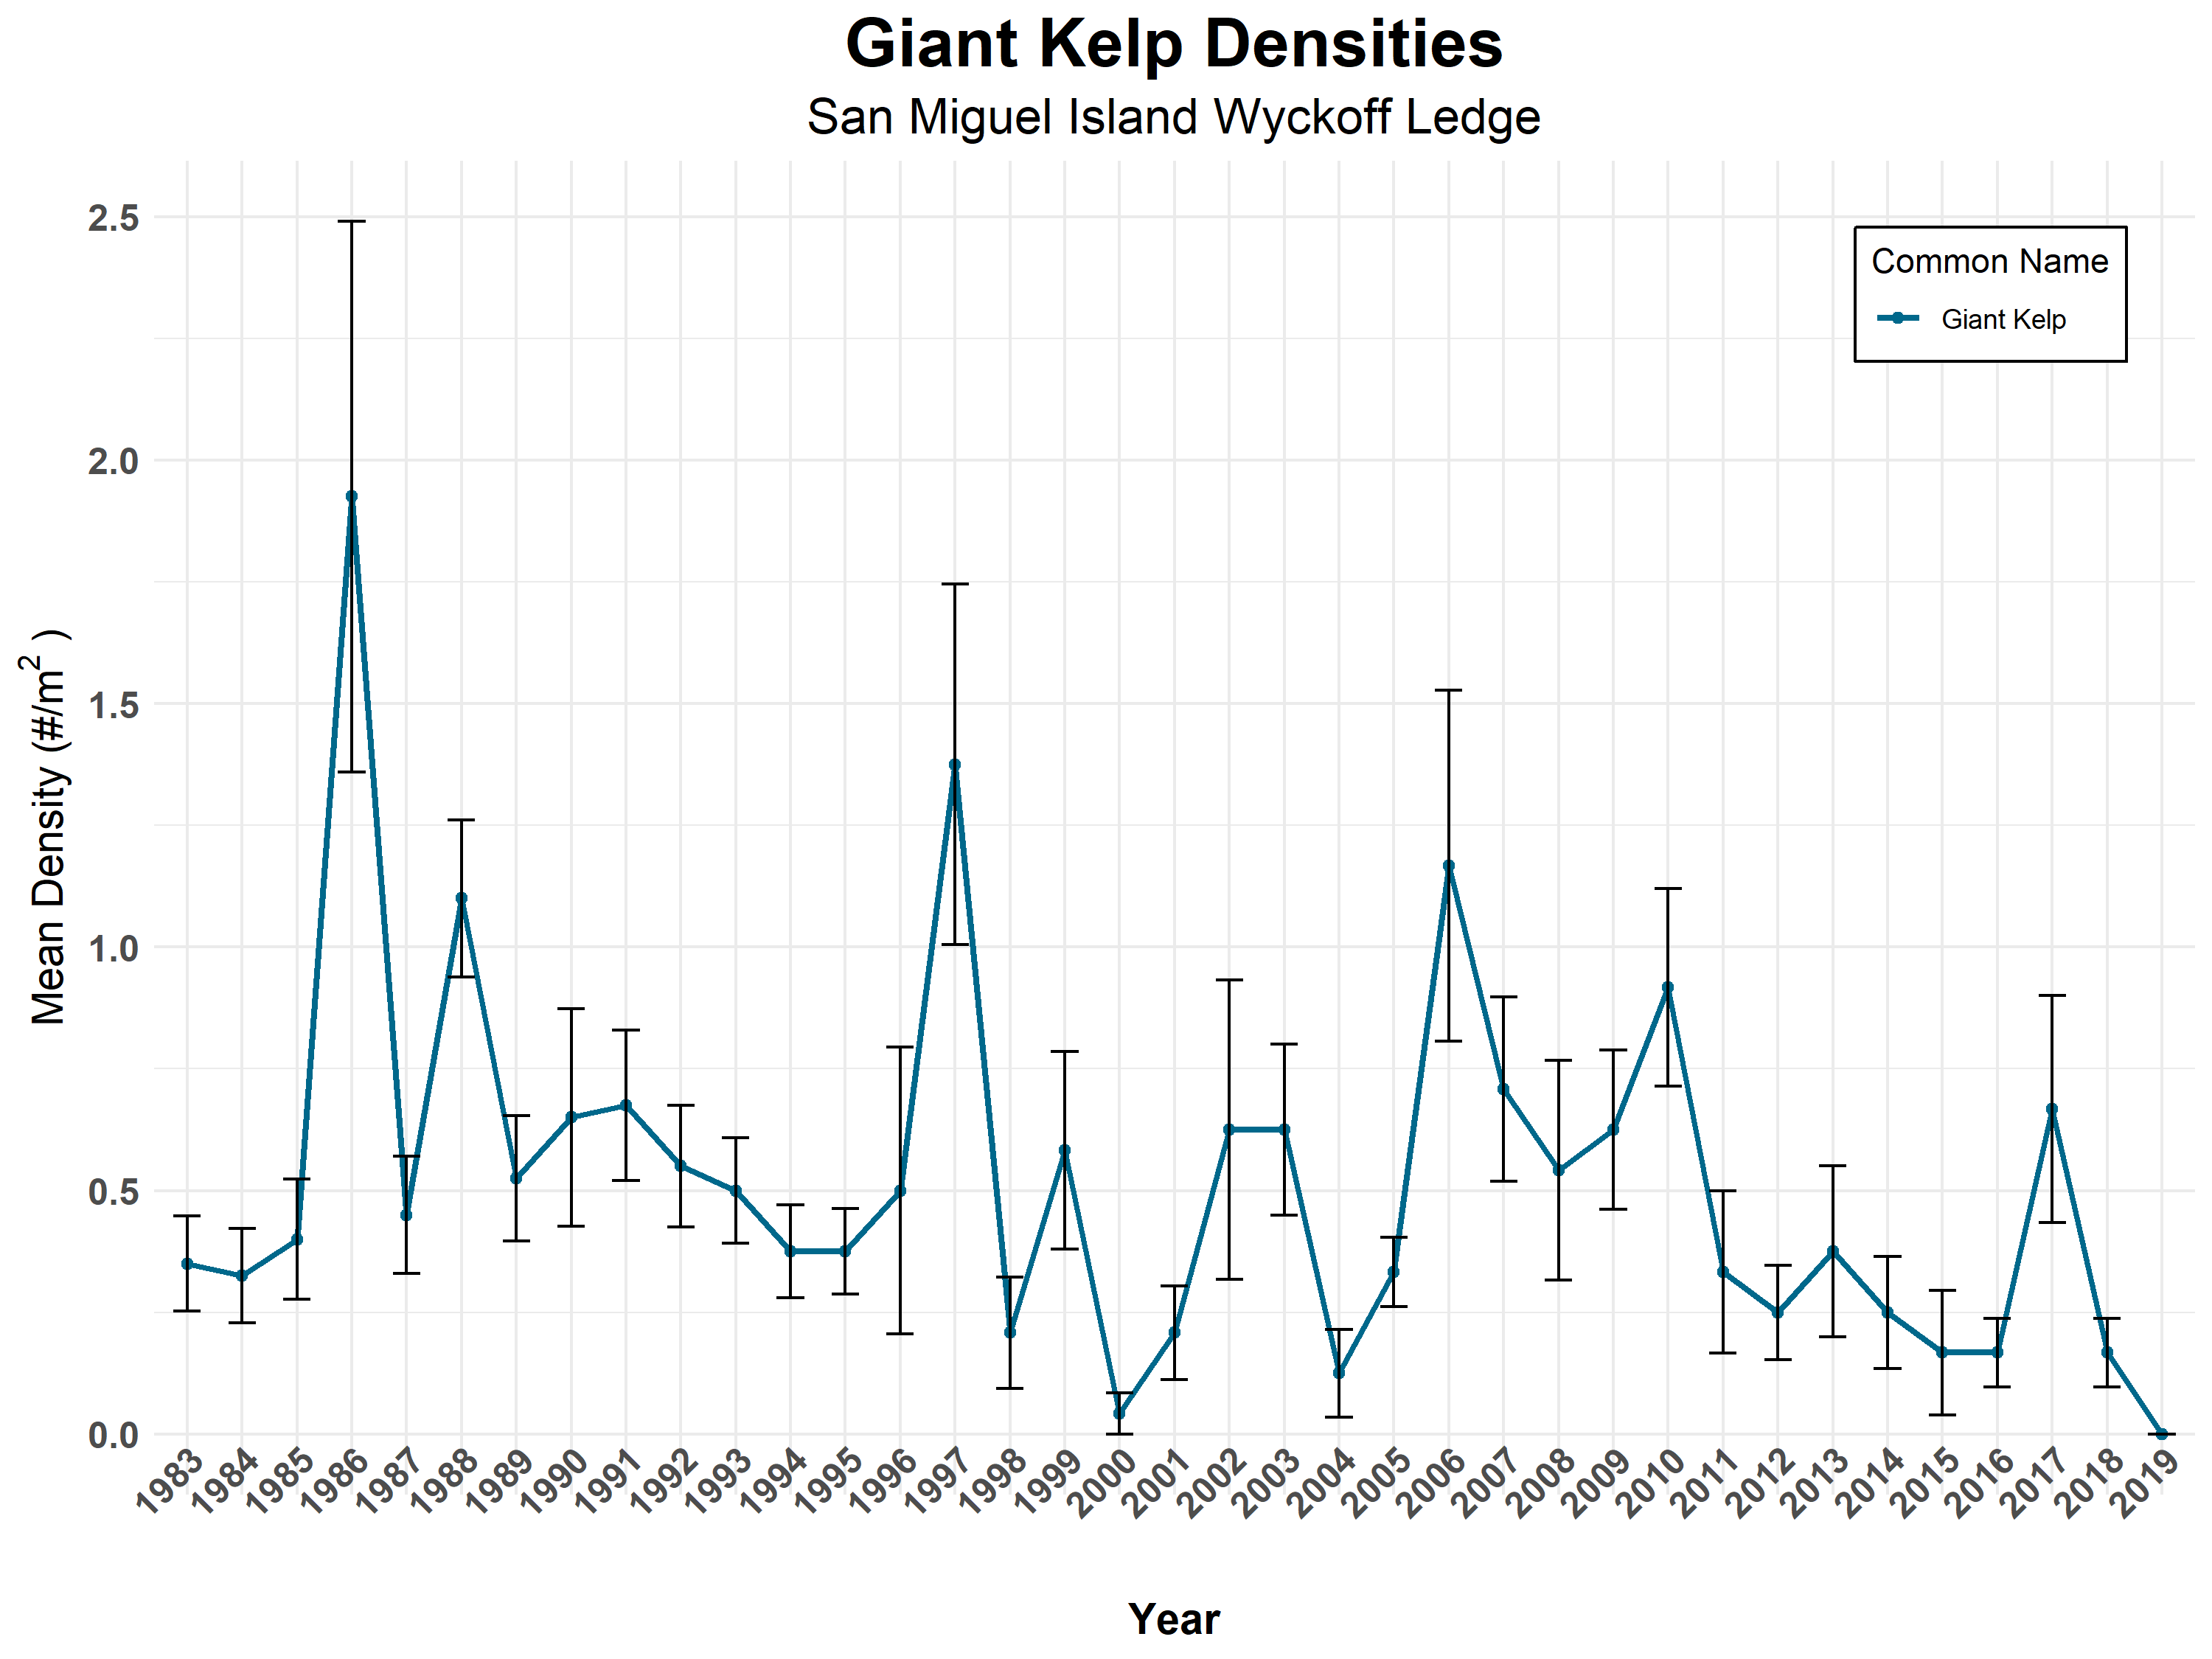

Slide 23
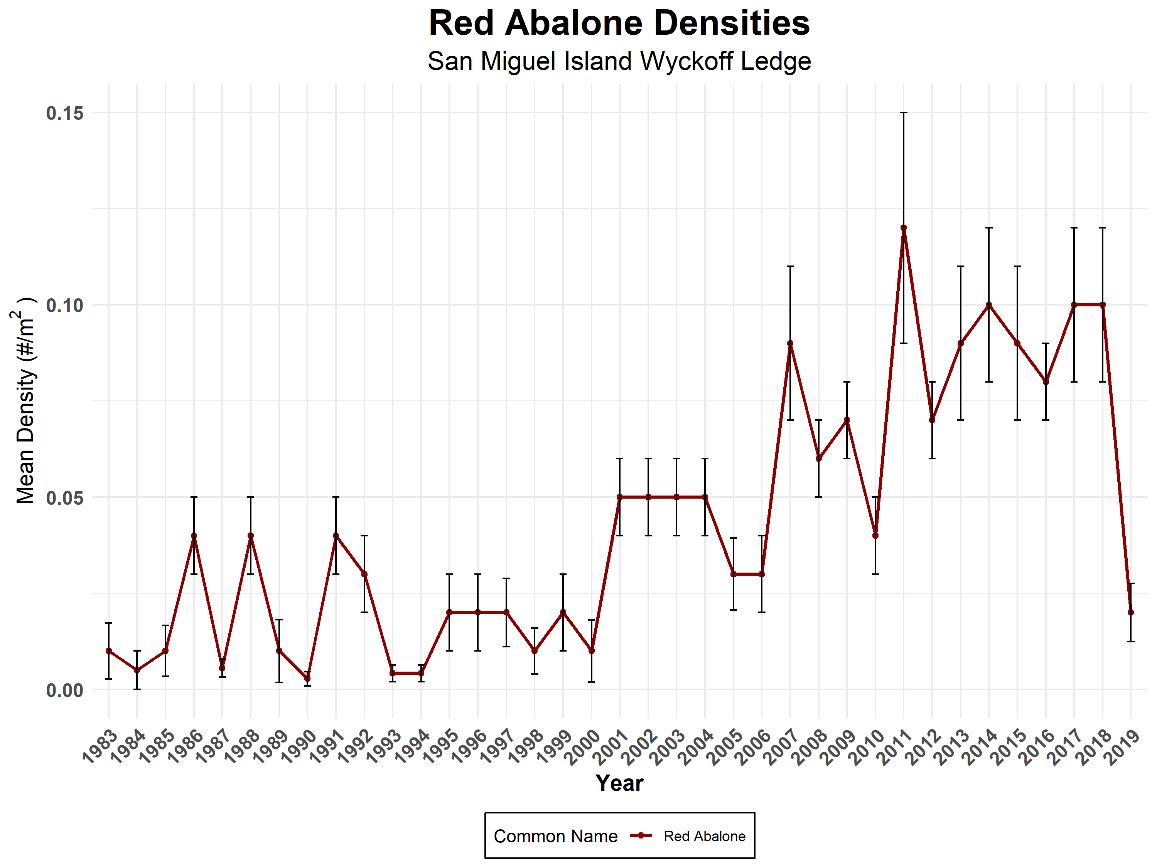

Slide 24
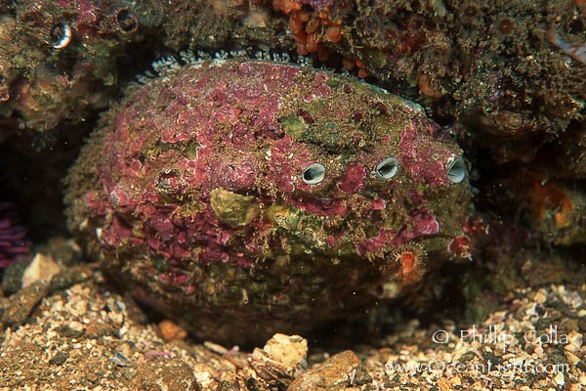

Slide 25
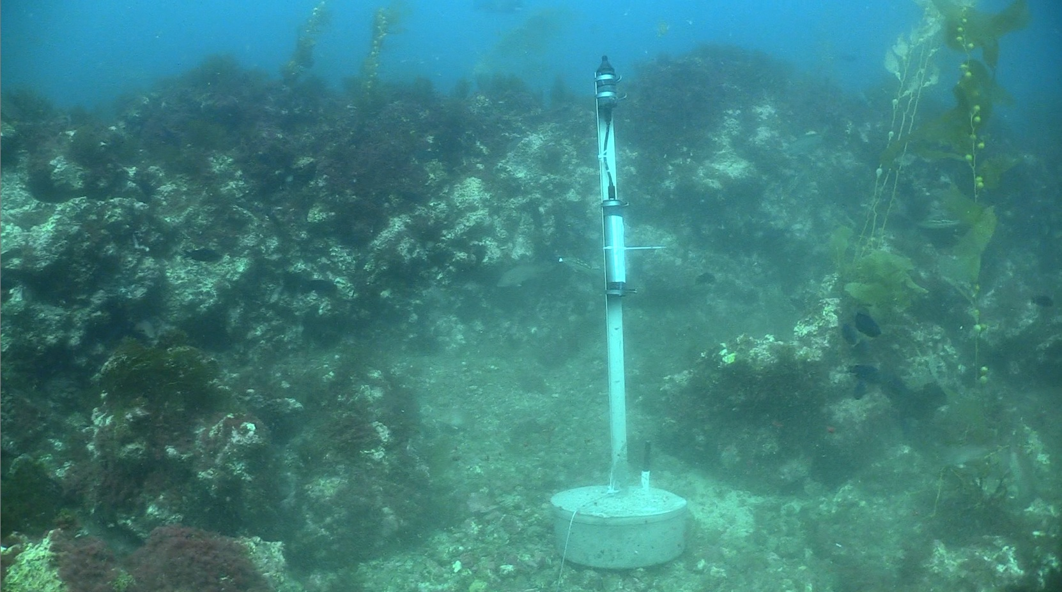
Acoustics Monitoring
Recent Collaborations
NPS Staff
Megan McKenna
Dave Conlin
David Kushner
Joshua Sprague
Eva Didonato
Purdue University
Ben Gottesman
David Savage

Slide 26
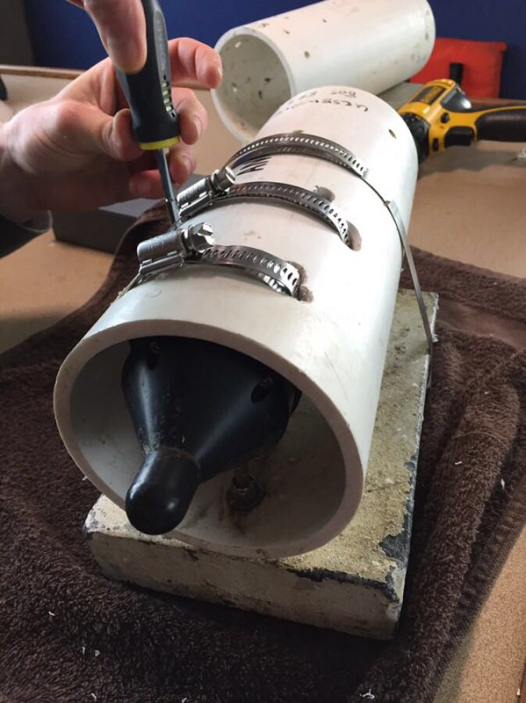
Acoustics Monitoring
Recent Collaborations

Slide 27
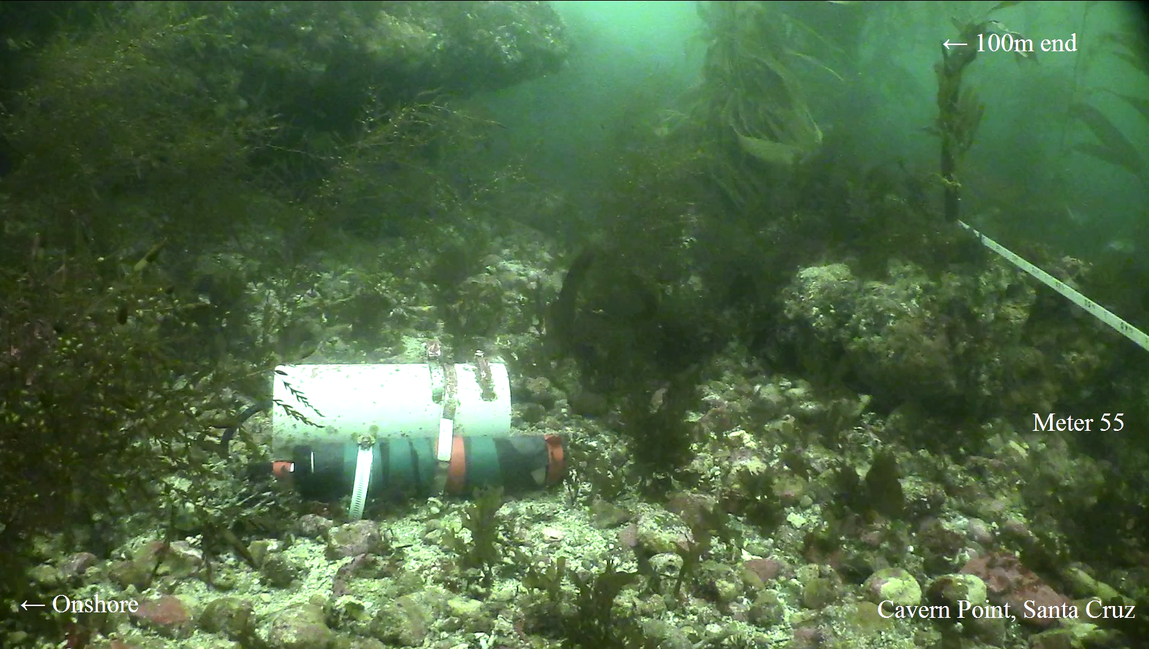
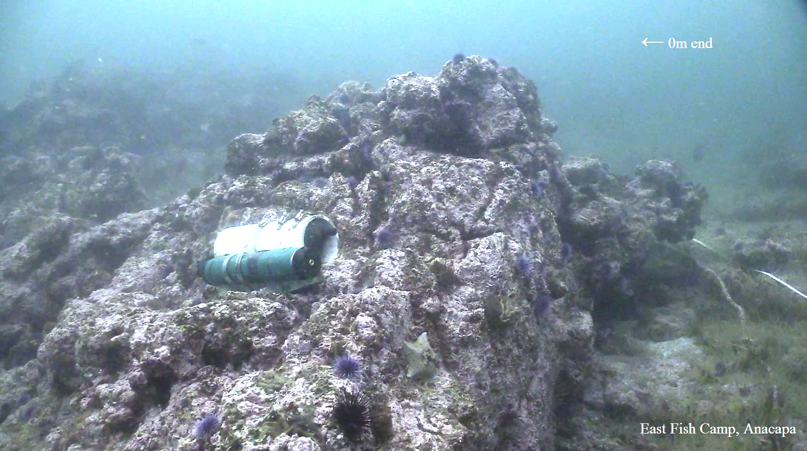
Recent Collaborations
Acoustics Monitoring
5 sites (3 MPA / 2 non-MPA)
First Deployed May 12, 2018)
5 minutes every 15 minutes

Slide 28
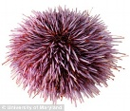

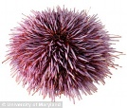
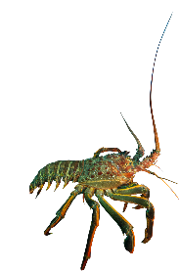
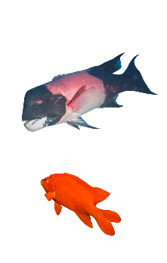
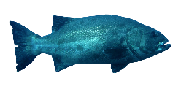
Recent Collaborations
Acoustics Monitoring
Soundscapes indicate kelp forest condition
High frequency sounds and snaps
Urchin + invertebrate density
Fish calls and choruses
Fish + kelp density
Sound frequency
Kelp forest condition
Notes:
Difference in the pyramid structure mimics the reverse trophic pyramid that is seen in kelp forests (greater predator biomass than prey)... A cool parallel to how the soundscape pyramid could invert with regime shifts
Stress that these results apply to these sites and we are still learning how they extrapolate to new habitats
Invertedd pyramid
https://dlpng.com/png/436468
https://sheillustrates.tumblr.com/image/141612692094
Blacksmith, water column,,, Barren closer to bottom

Slide 29
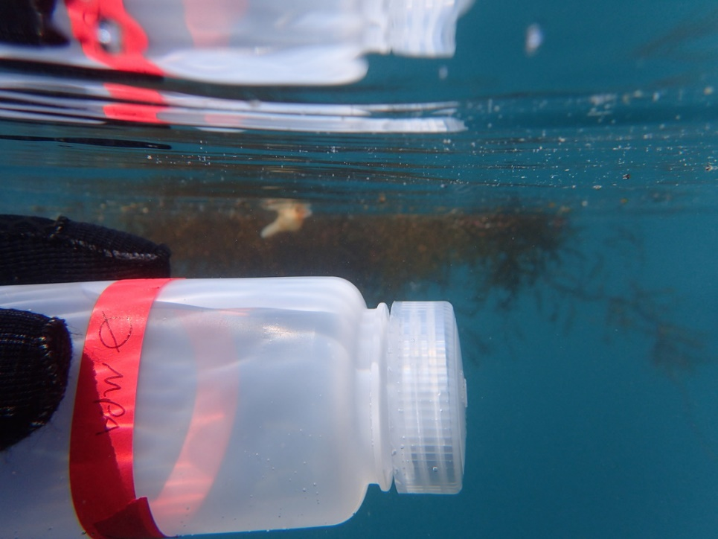
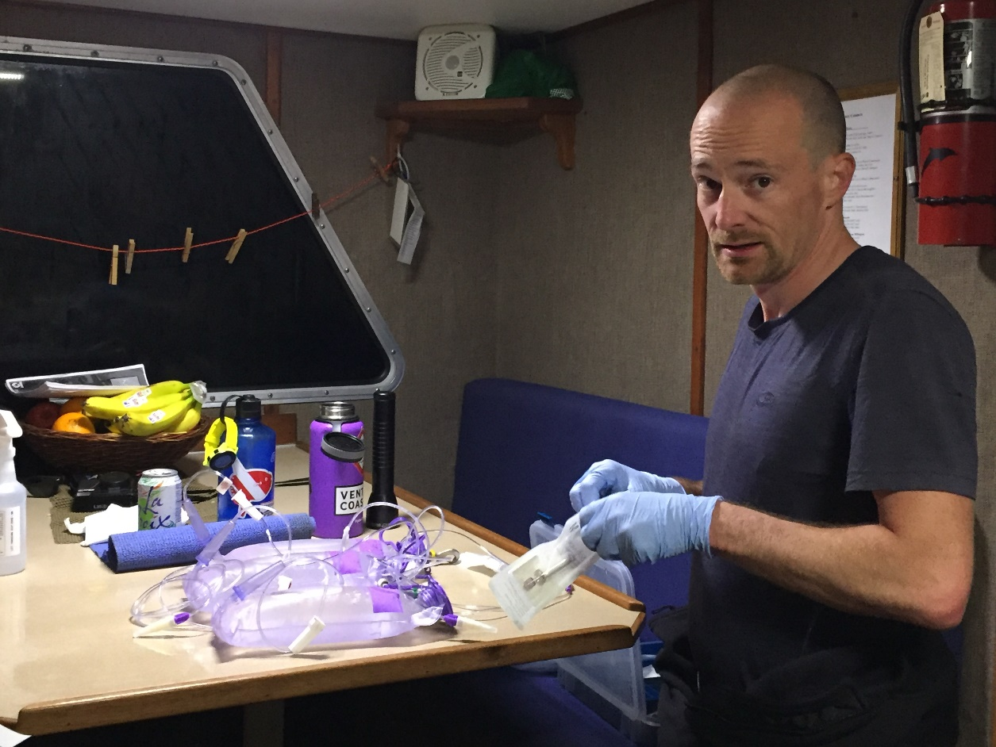
Recent Collaborations
eDNA Monitoring
Year 1
33 samples collected from 33 sites
Year 2
72 samples collected from 24 sites (12 mpa/ 12 non-mpa)

Slide 30
Recent Collaborations
eDNA Monitoring

Slide 31
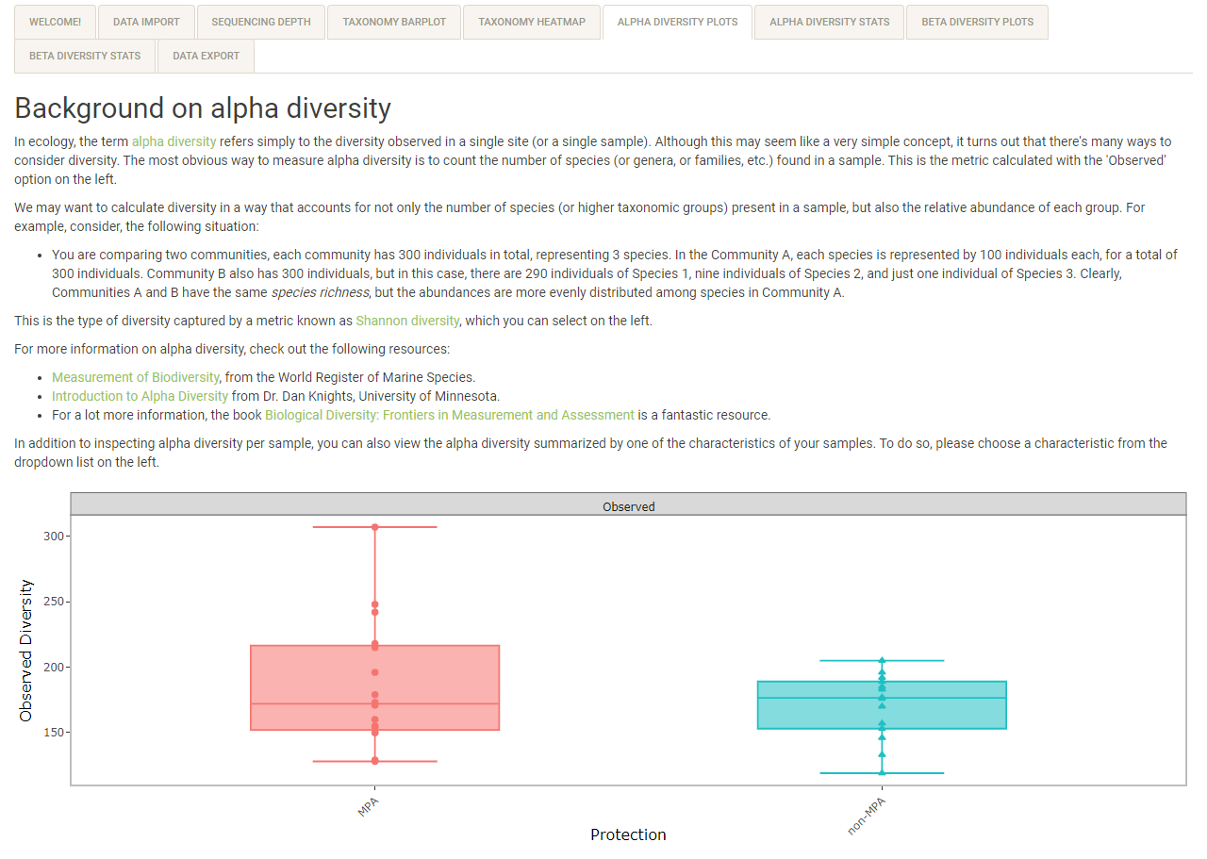
Recent Collaborations
eDNA Monitoring

Slide 32
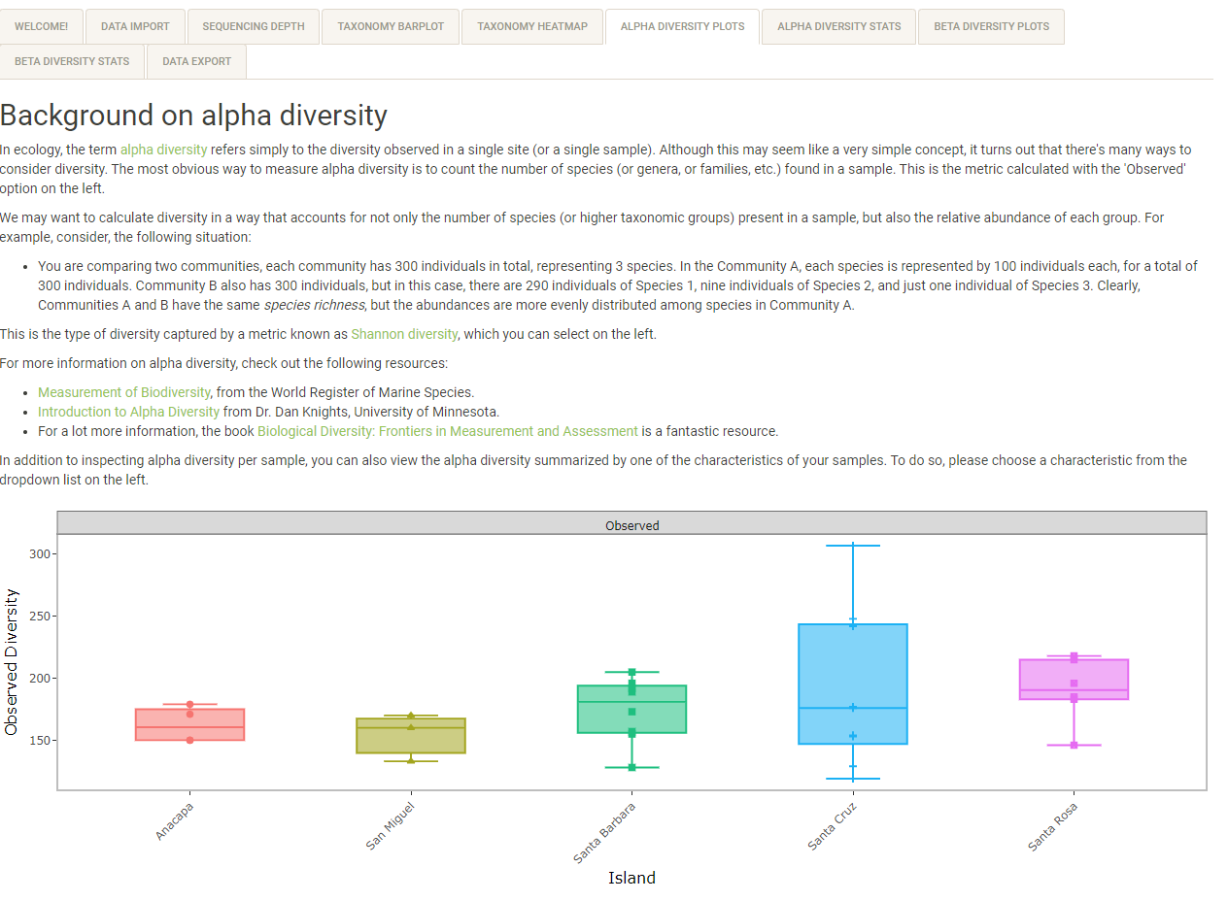
Recent Collaborations
eDNA Monitoring

Slide 33
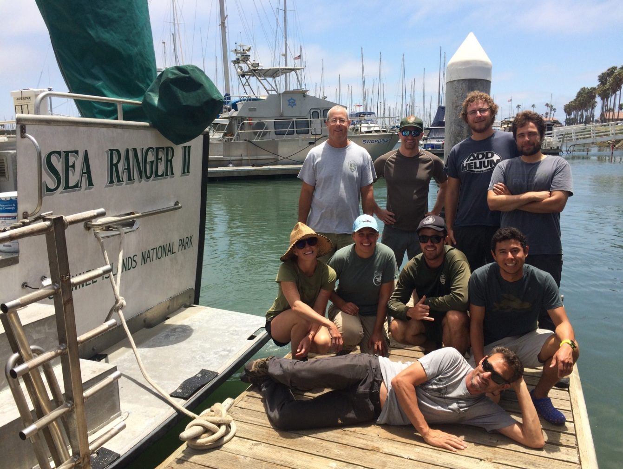
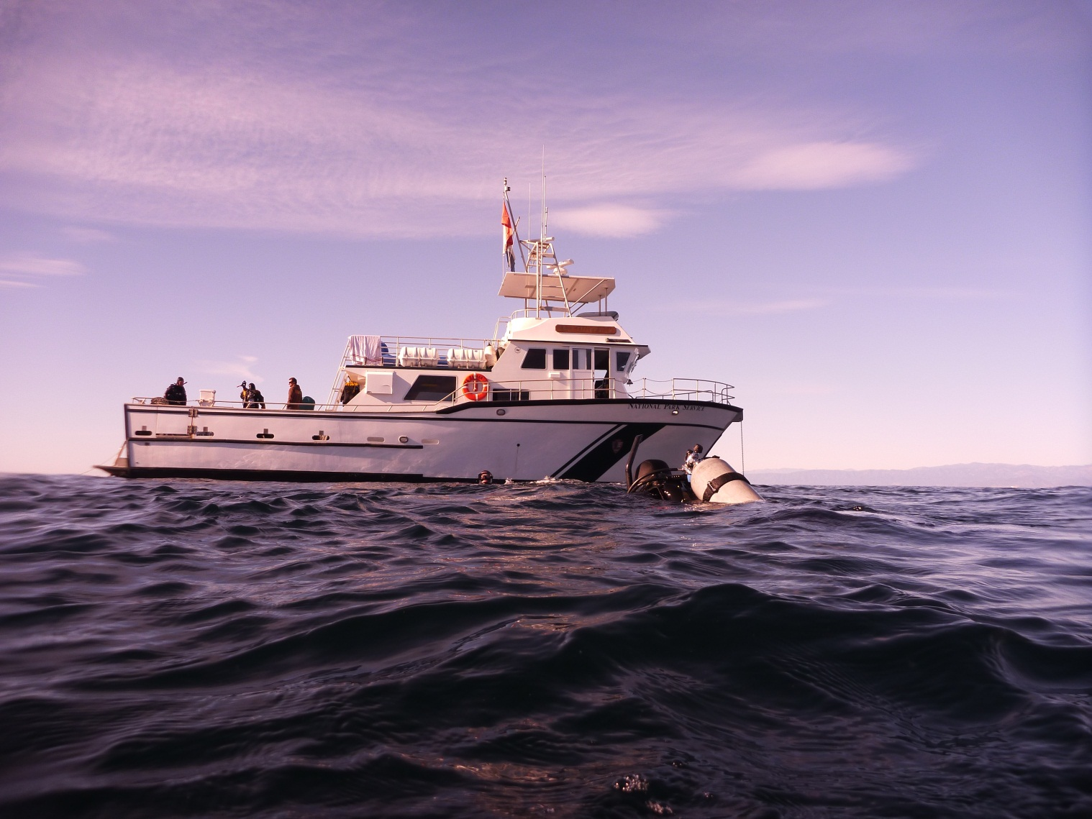
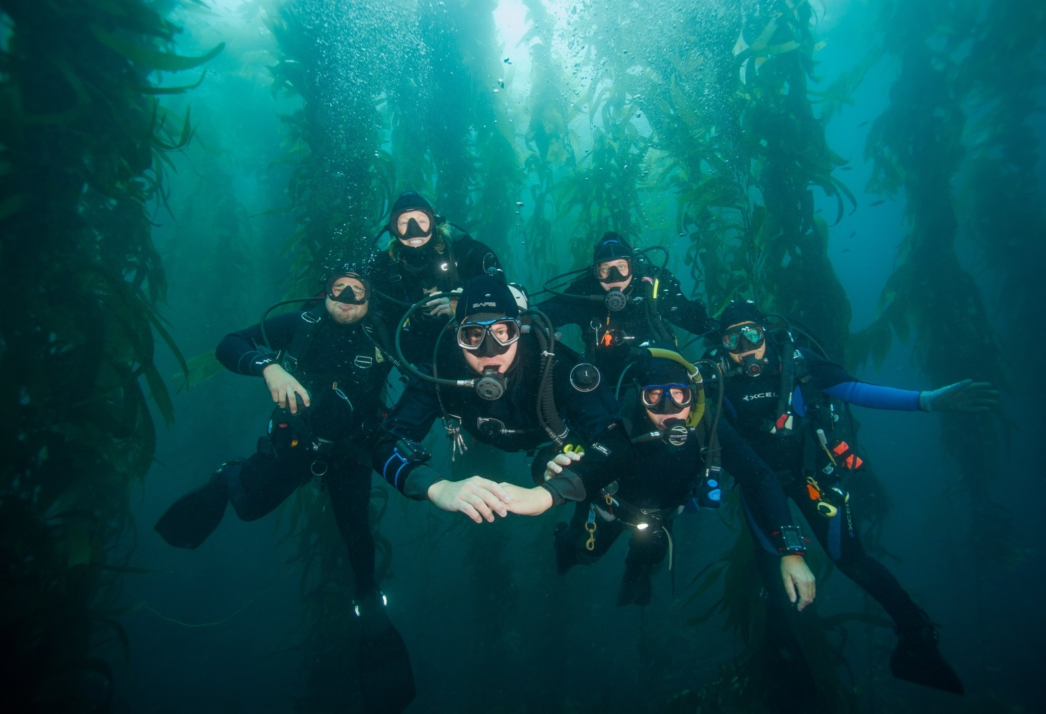

The Kelp Forest Monitoring Team

